Slide 1
Conway’s
Game of Life
Mystery Team
Members:
JiaWen Li, Isaiah Smith, Tin Huynh,
Hyunki Lee, Sang Kim

Slide 2
Team Members / Roles
Team Leader: Tin Huynh - Research, Game Functions, Tester/Debugger
Developer / QA: JiaWen Li - Research, PPT, Tester/Debugger
Developer / QA: Sang Kim - Research, CSS Design, PPT, Tester/Debugger
Developer / QA: Hyunki Lee - UML Class Diagram, Zenhub, Tester/Debugger
Developer / QA: Isaiah Smith - Develop Login and Signup page, Video

Slide 3
01
02
03
Introduction
Demonstration
Code Explanation
Contents

Slide 4
Conway’s Game of Life Rules
Any live cell with fewer than two live neighbours dies, as if by underpopulation.
Any live cell with two or three live neighbours lives on to the next generation.
Any live cell with more than three live neighbours dies, as if by overpopulation.
Any dead cell with exactly three live neighbours becomes a live cell, as if by reproduction.

Slide 5
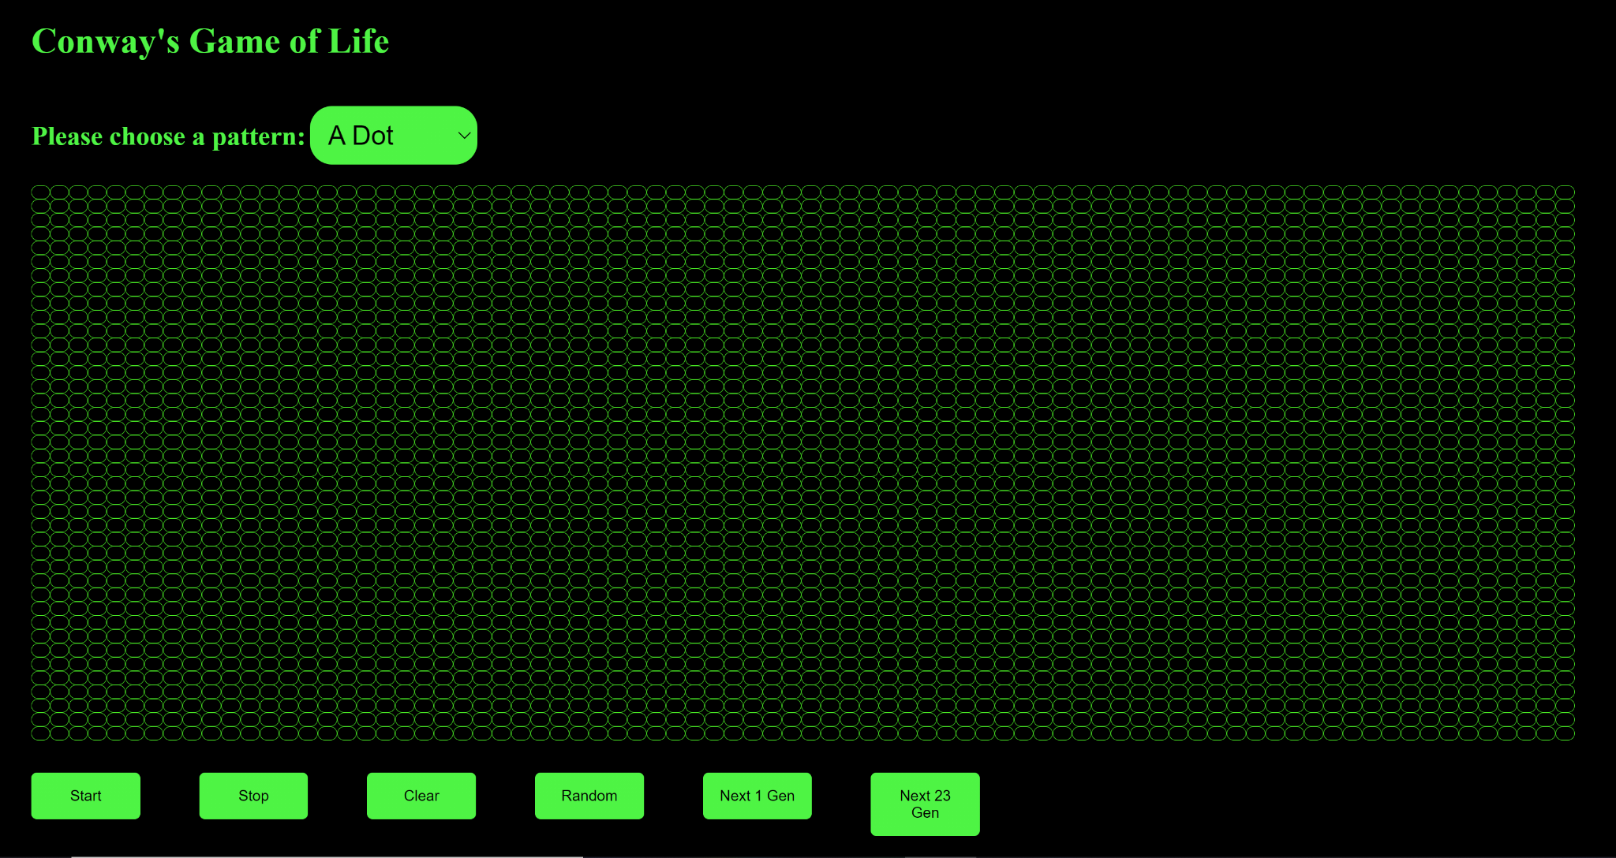
Game Screen

Slide 6
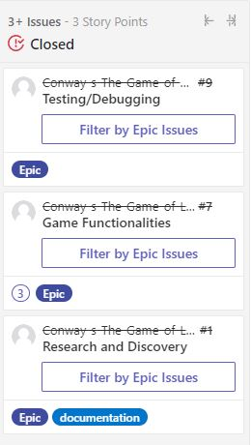
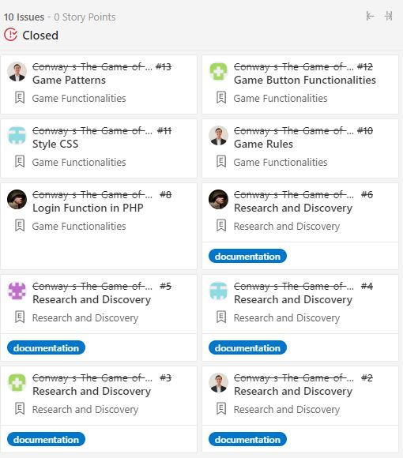
Discord and Zenhub
Most communication happened in Discord.
We used Zenhub to organize and plan the coding in a very effective way.
We created three epics and ten issues

Slide 7
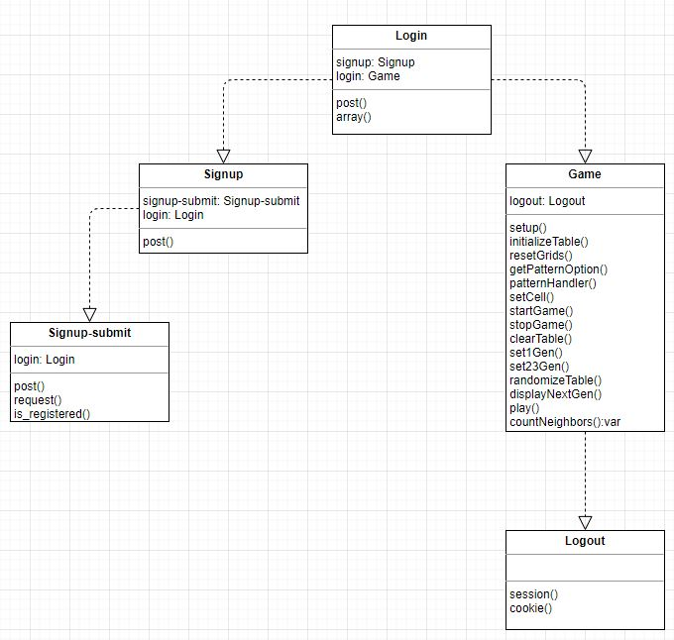
UML Diagram
Relationship between each class
Main functions are represented in each class

Slide 8
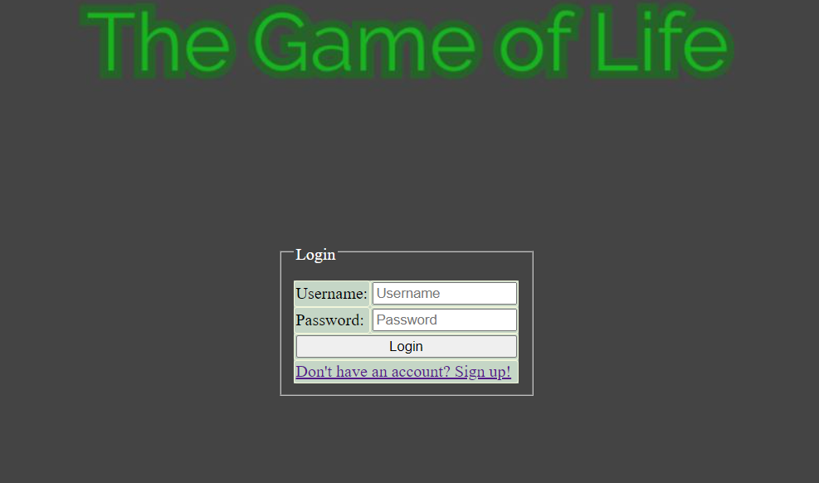
Login Screen
Login Screen Developed using PHP.
Prompts user for Username/Password
Links to Sign Up Page

Slide 9
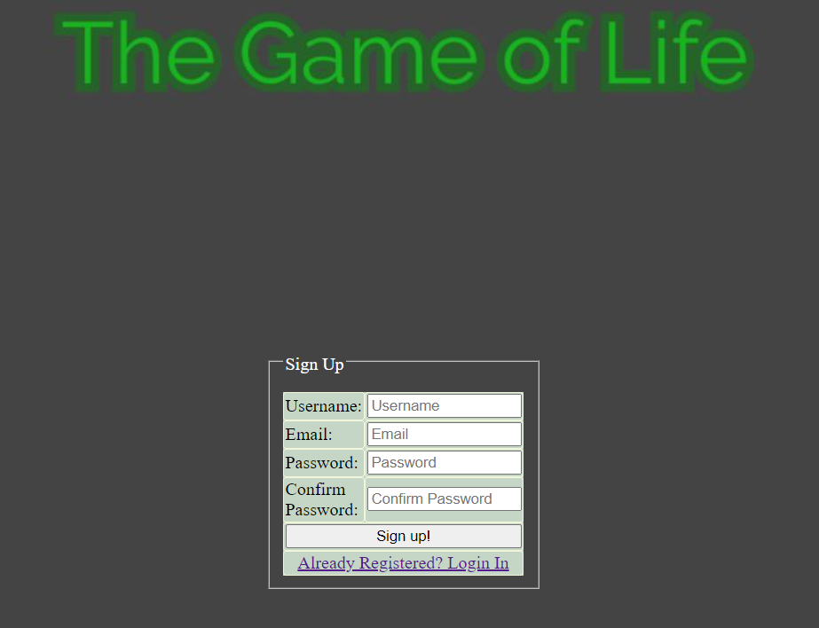
Sign Up Screen
Developed using PHP.
Prompts user for Username, Email, Password
Links to Login Page
Checks if the user credentials are valid.

Slide 10
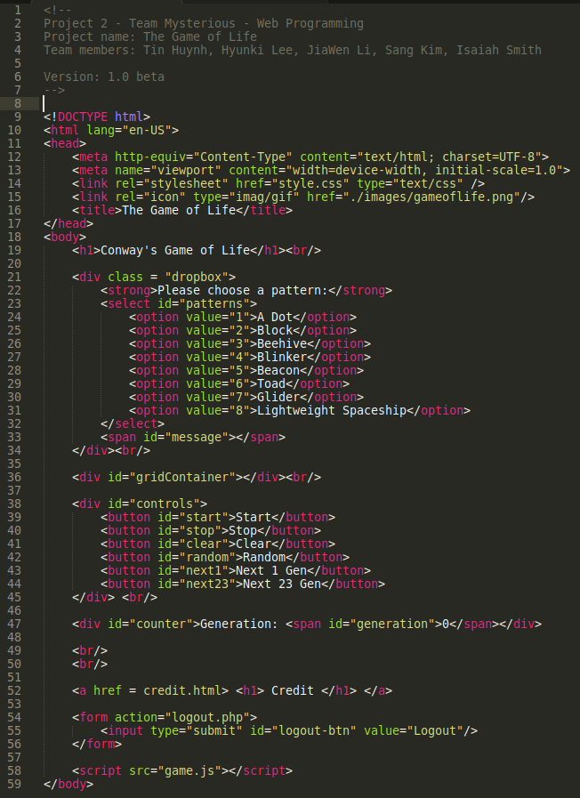
HTML Code:
Layout for the game

Slide 11
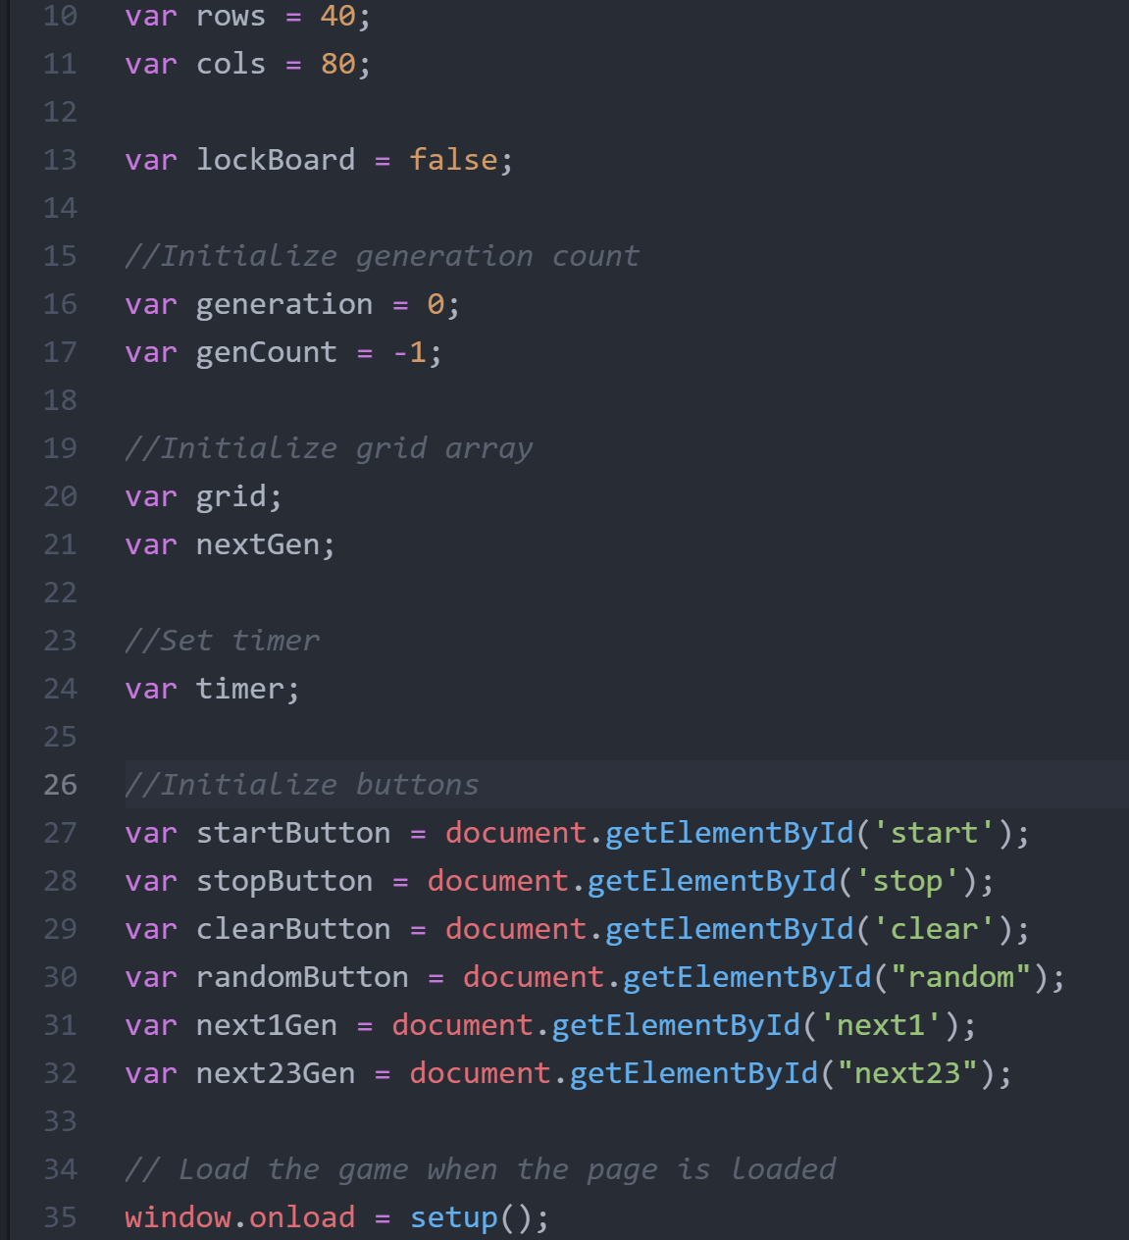
JS Code:
Declaration and initialization for code

Slide 12
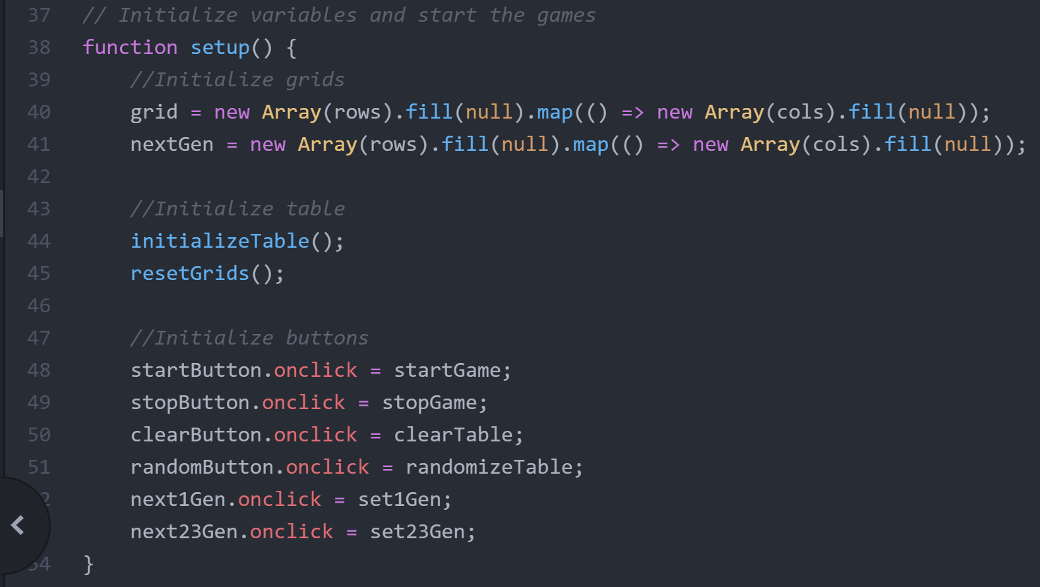
JS Code:
Game function

Slide 13
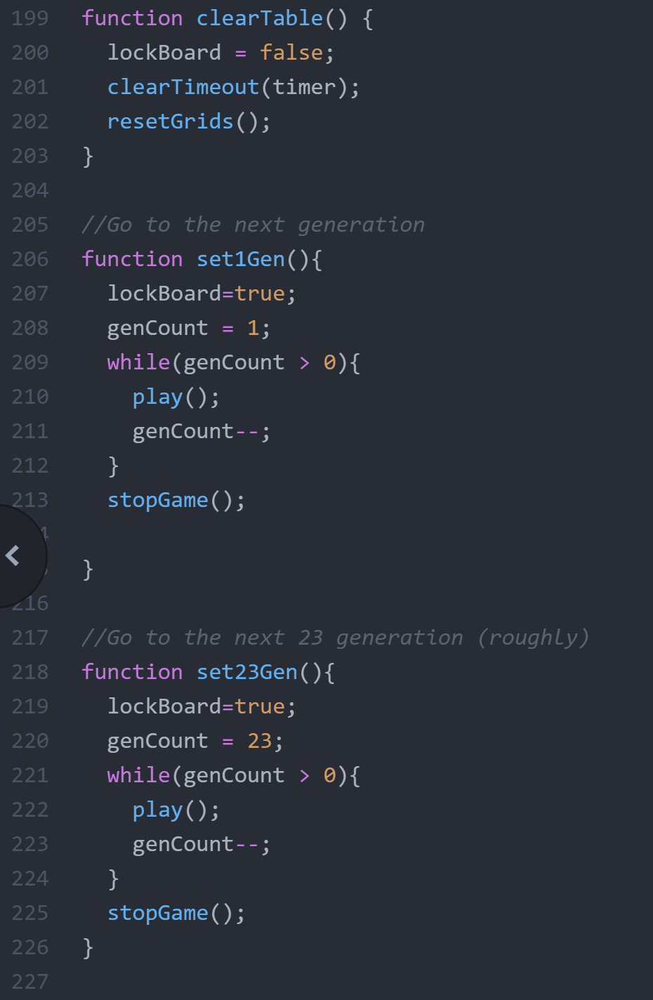
JS Code:
Code function process

Slide 14
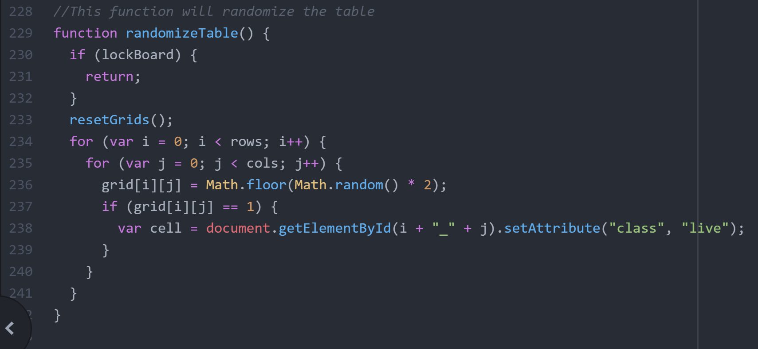
JS Code:
Code random.

Slide 15
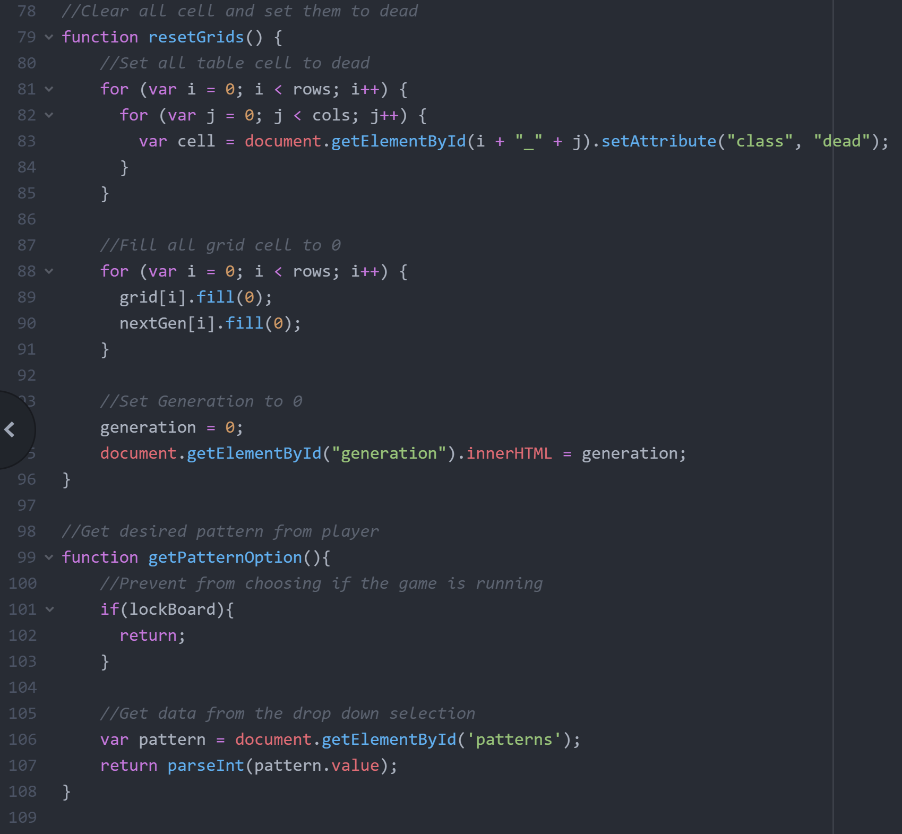
JS Code:
Cell function

Slide 16
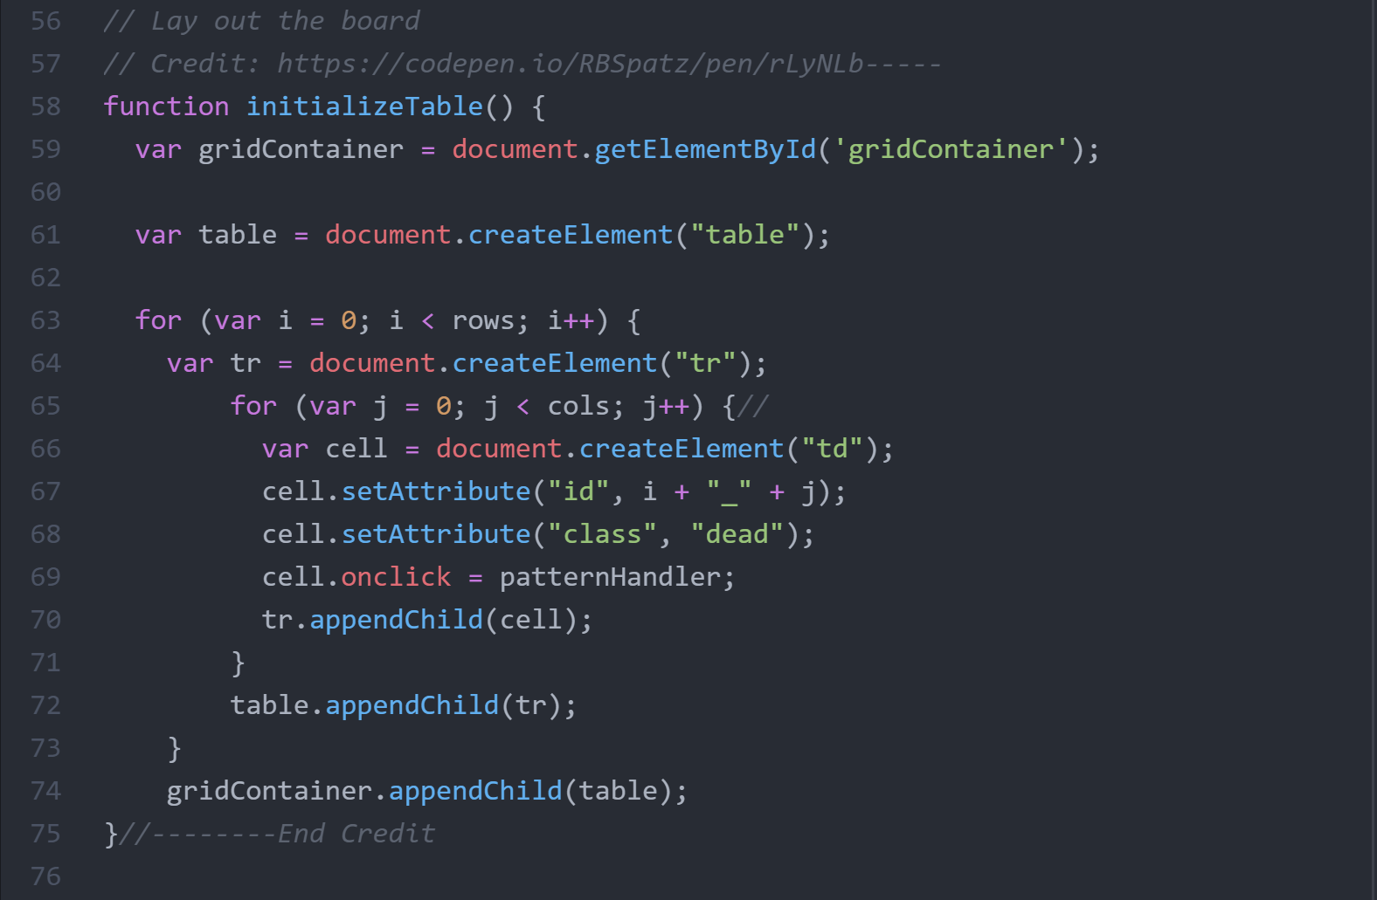
JS Code:
This function will create empty table, set ID to each cell, and set class to dead
Notes:
The key point for this game is that we use element class and CSS style to control the animation of cell dead or alive.

Slide 17
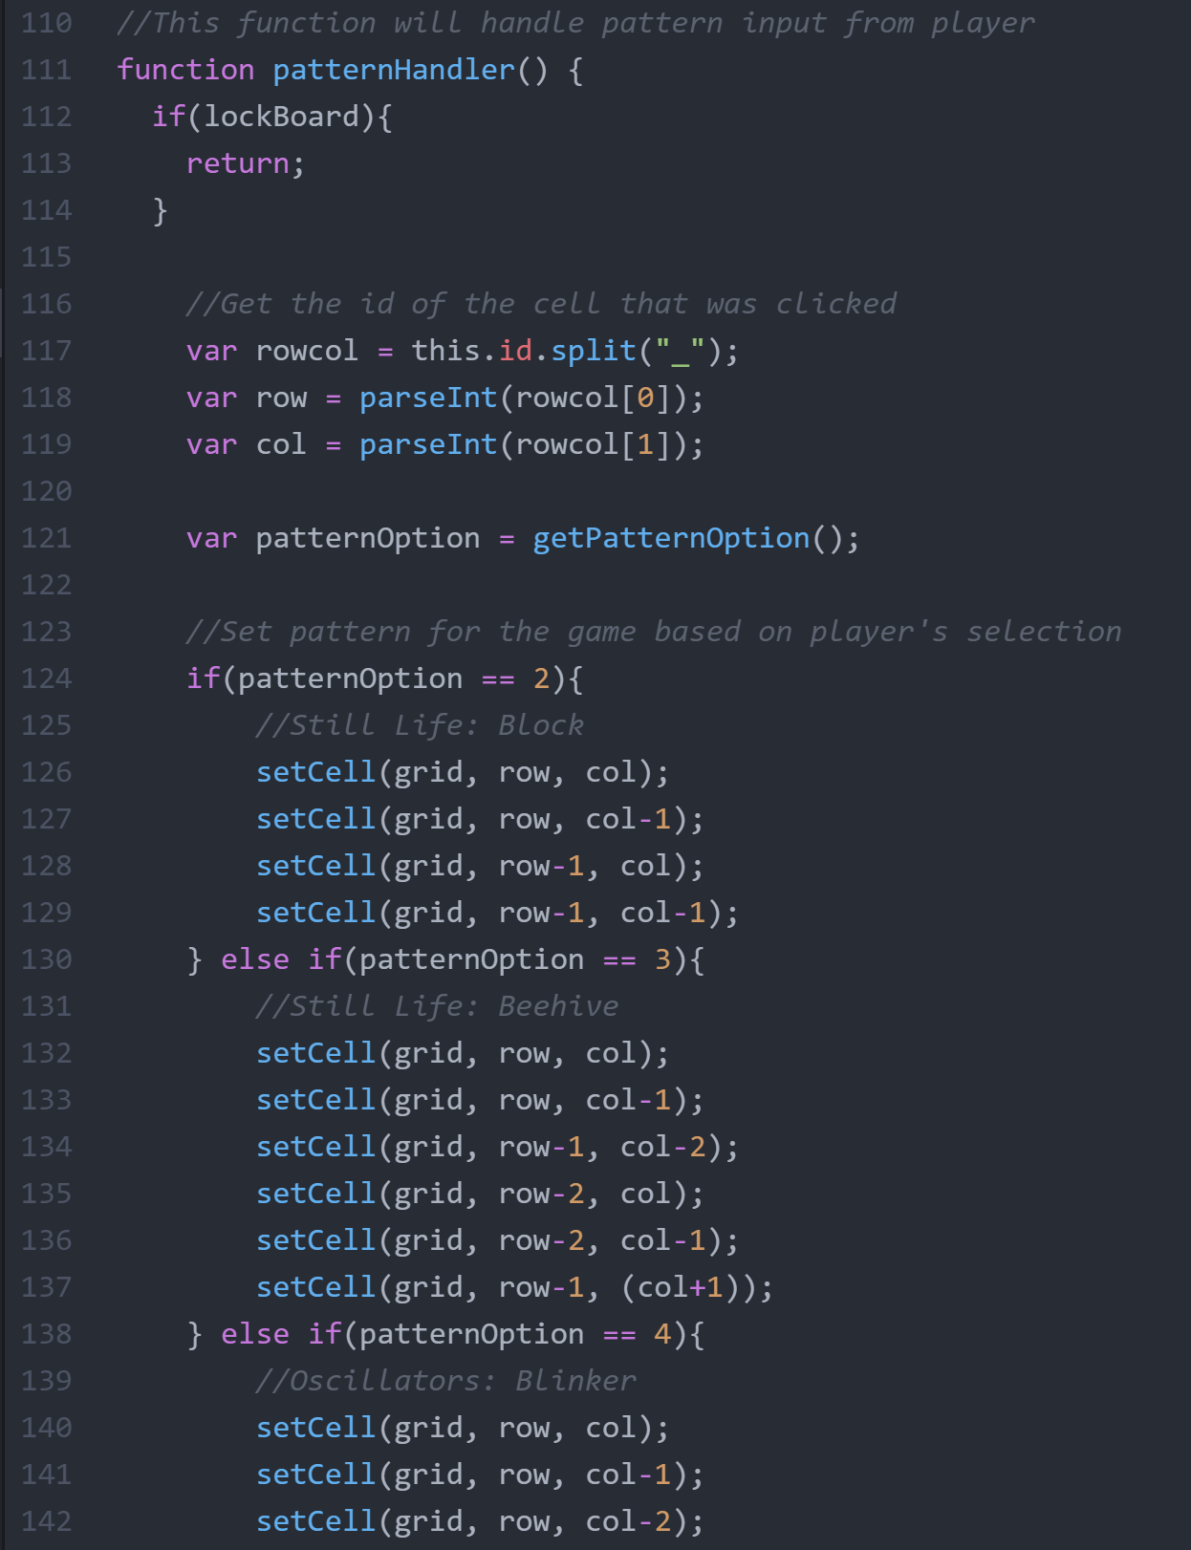
JS Code:
This function will get the ID of the clicked cells and set the pattern to neighbor cells

Slide 18
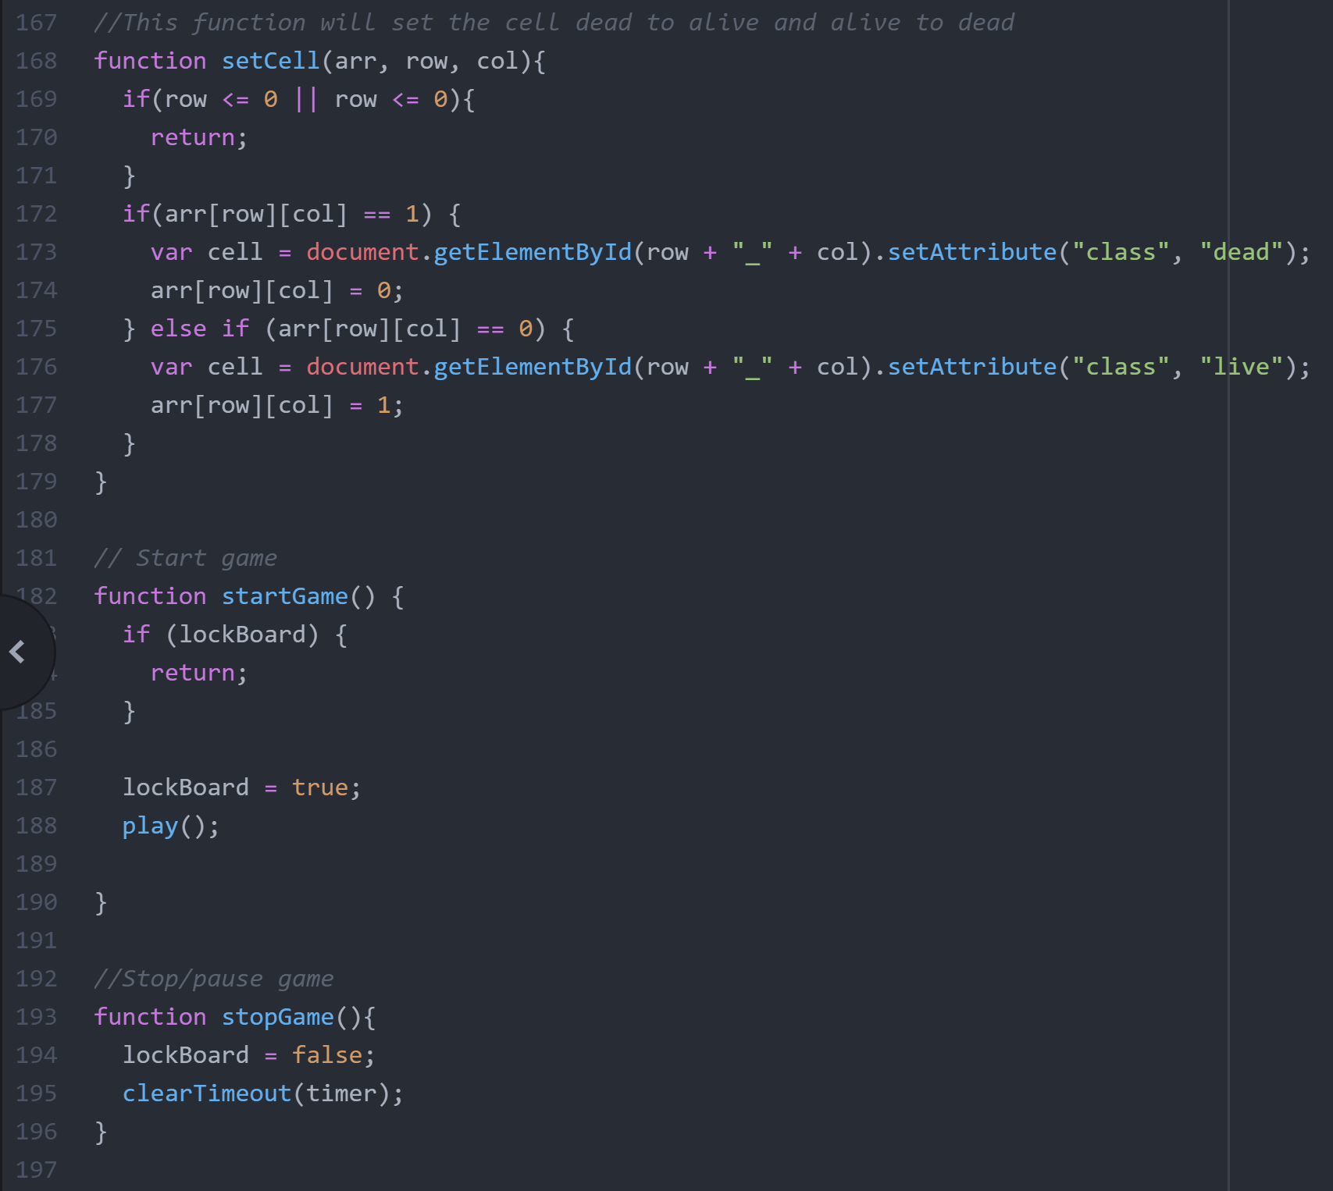
JS Code:
This function will try to set the desired pattern on the table

Slide 19
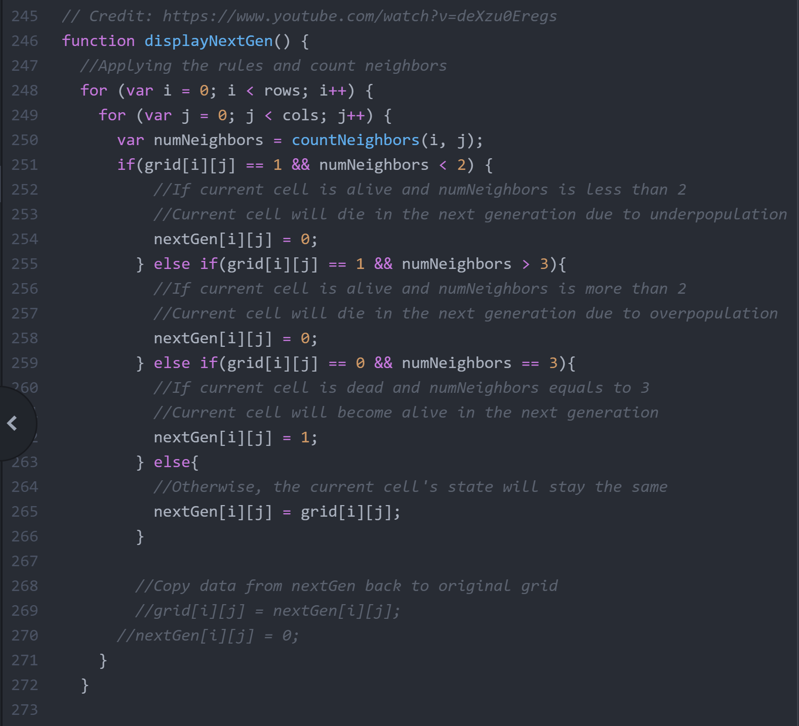
JS Code:
This function will apply the game rules, set the table for next generation, and count generation

Slide 20
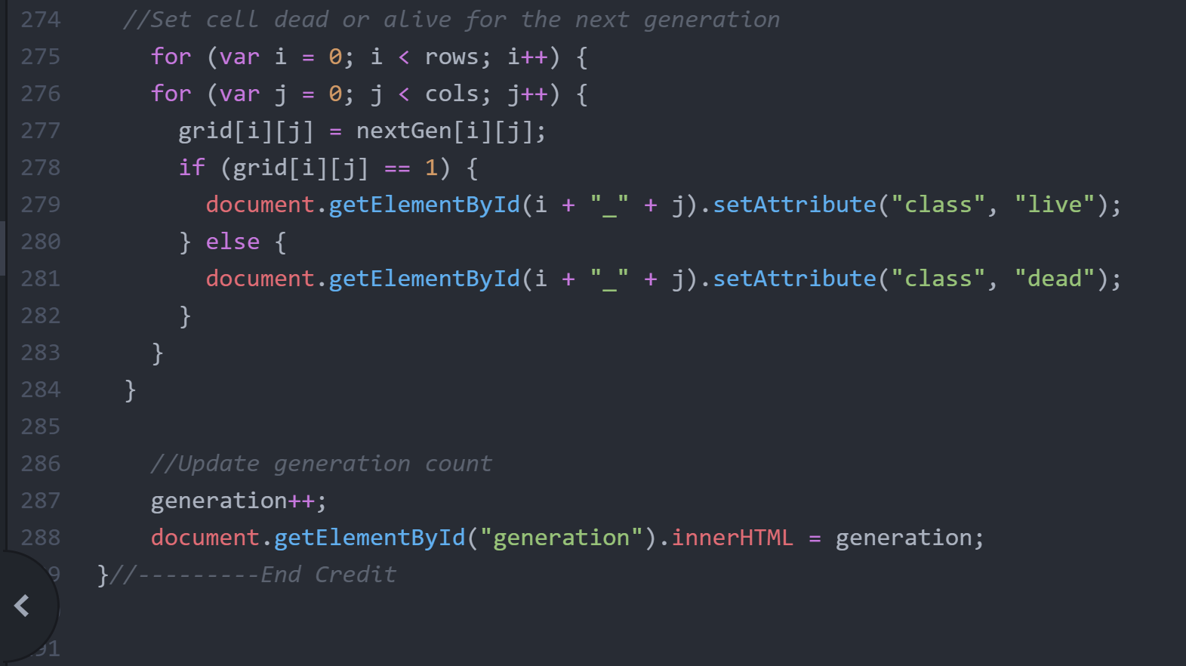
JS Code:

Slide 21
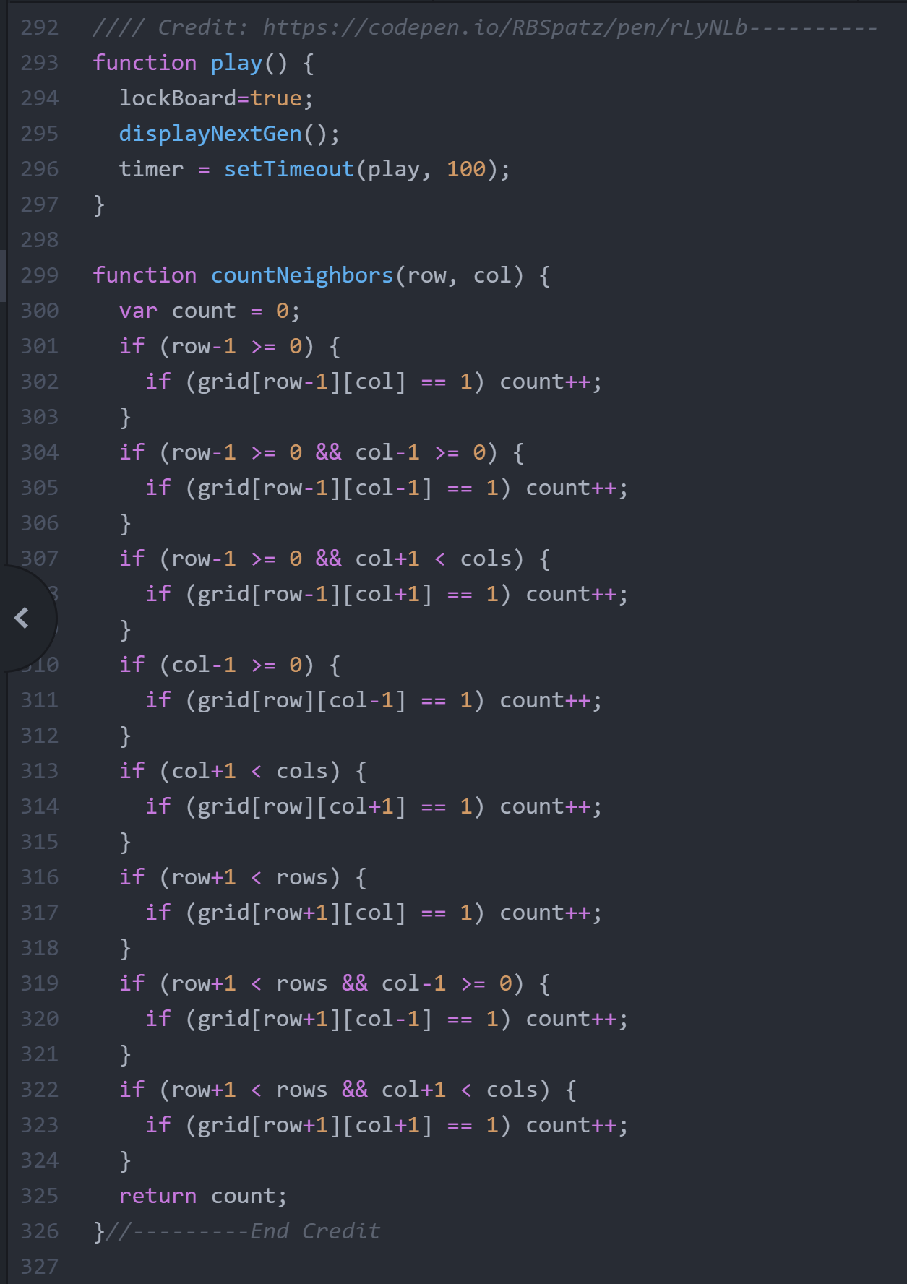
JS Code:
countNeighbors function is very crucial to displayNextGen function

Slide 22
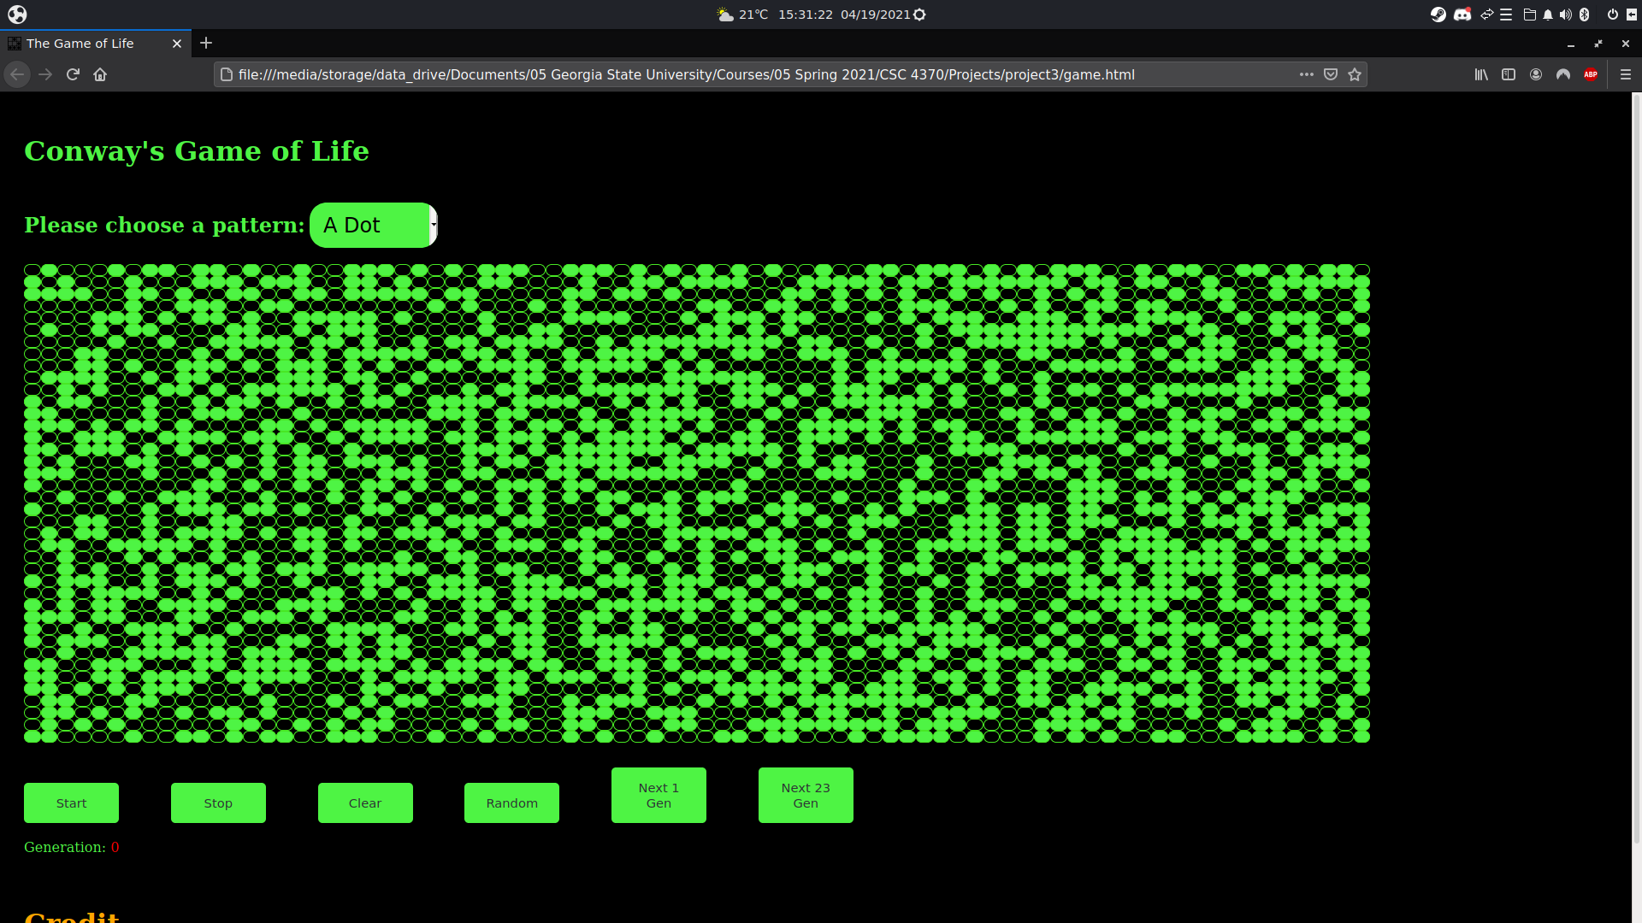
Test Case 1
Random patterns

Slide 23
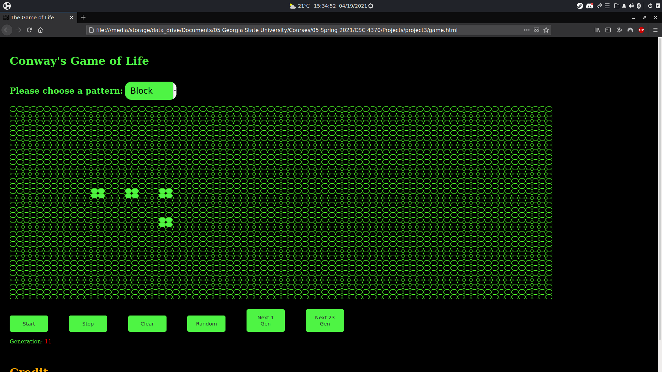
Test Case 2
Still Life Pattern:
Block

Slide 24
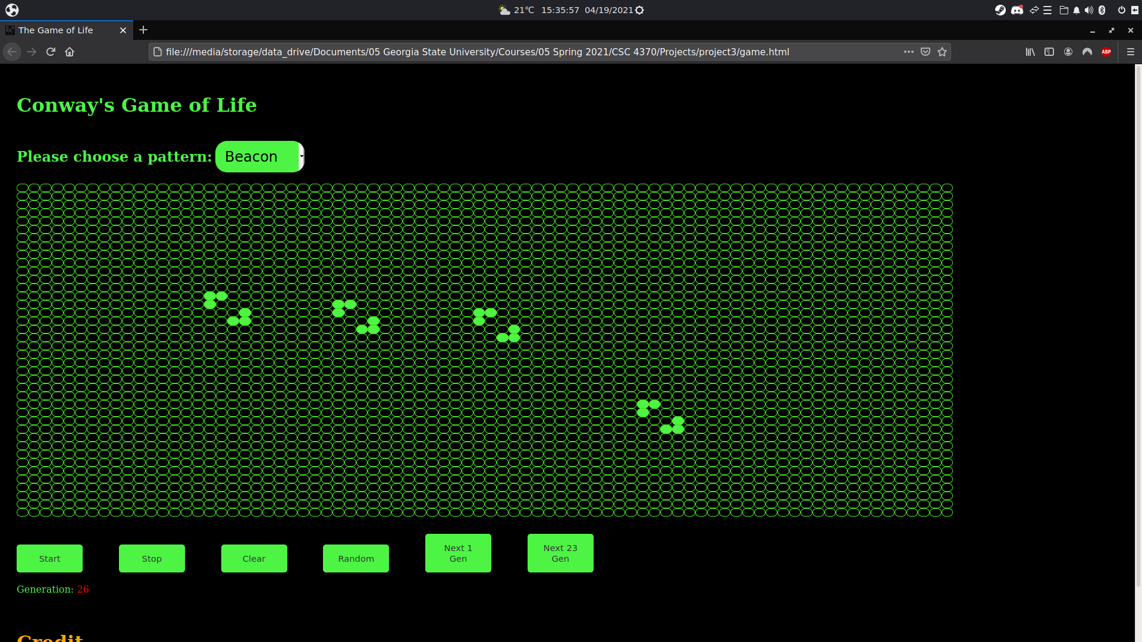
Test Case 3
Oscillator Pattern:
Beacon

Slide 25
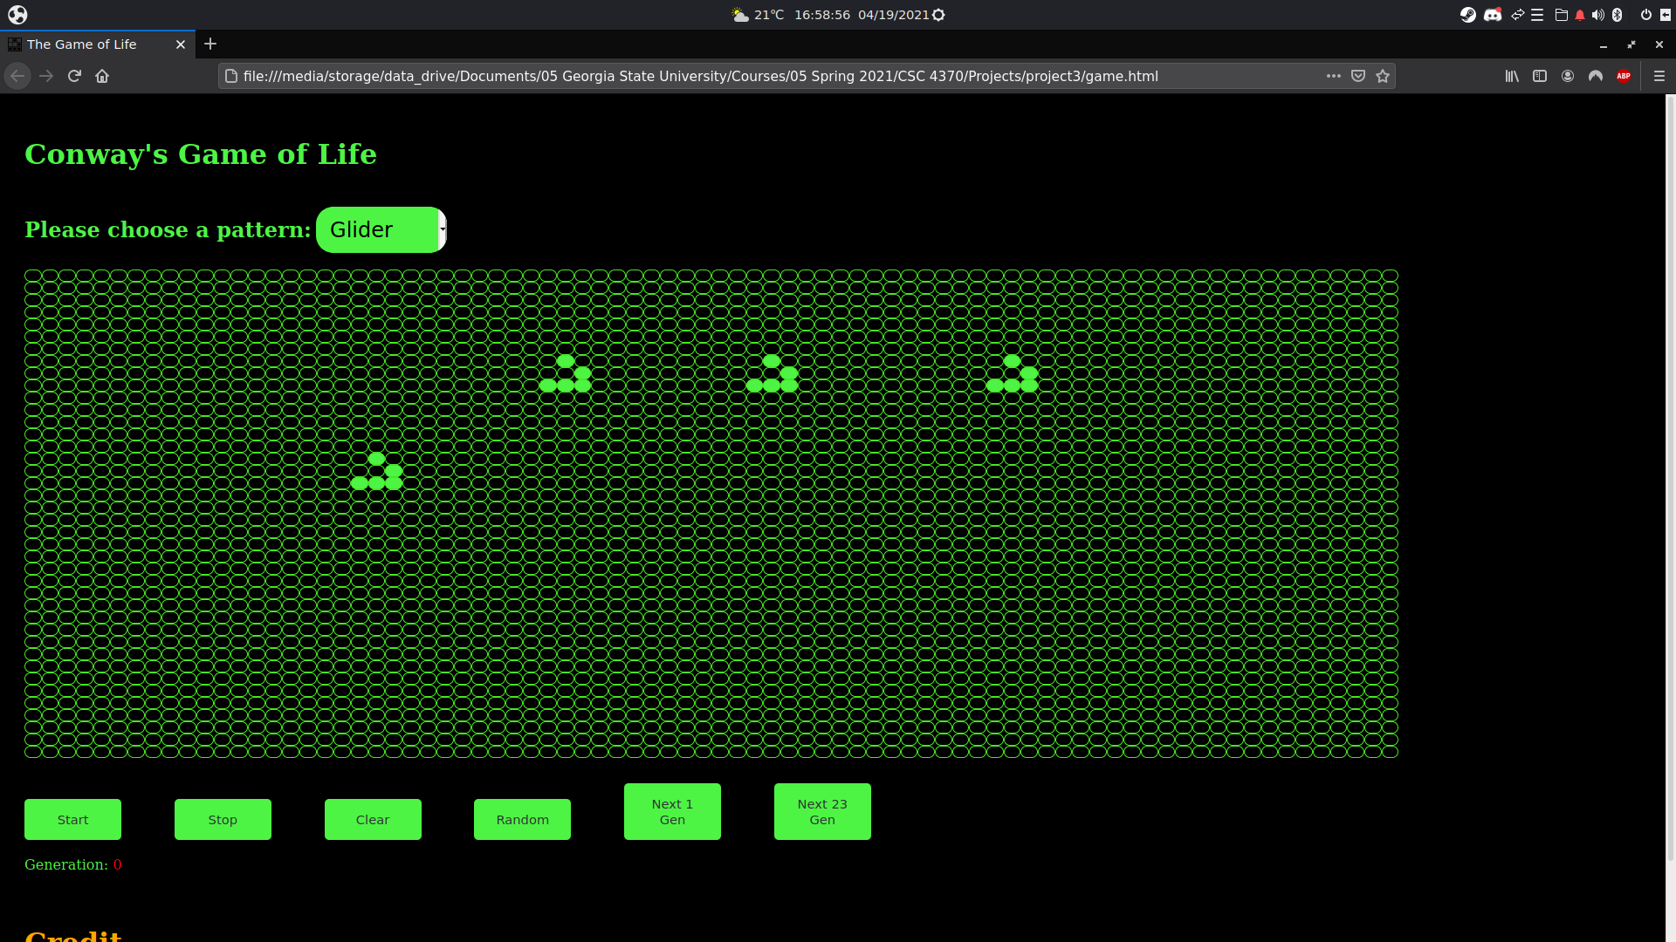
Test Case 4
Glider Pattern

Slide 26
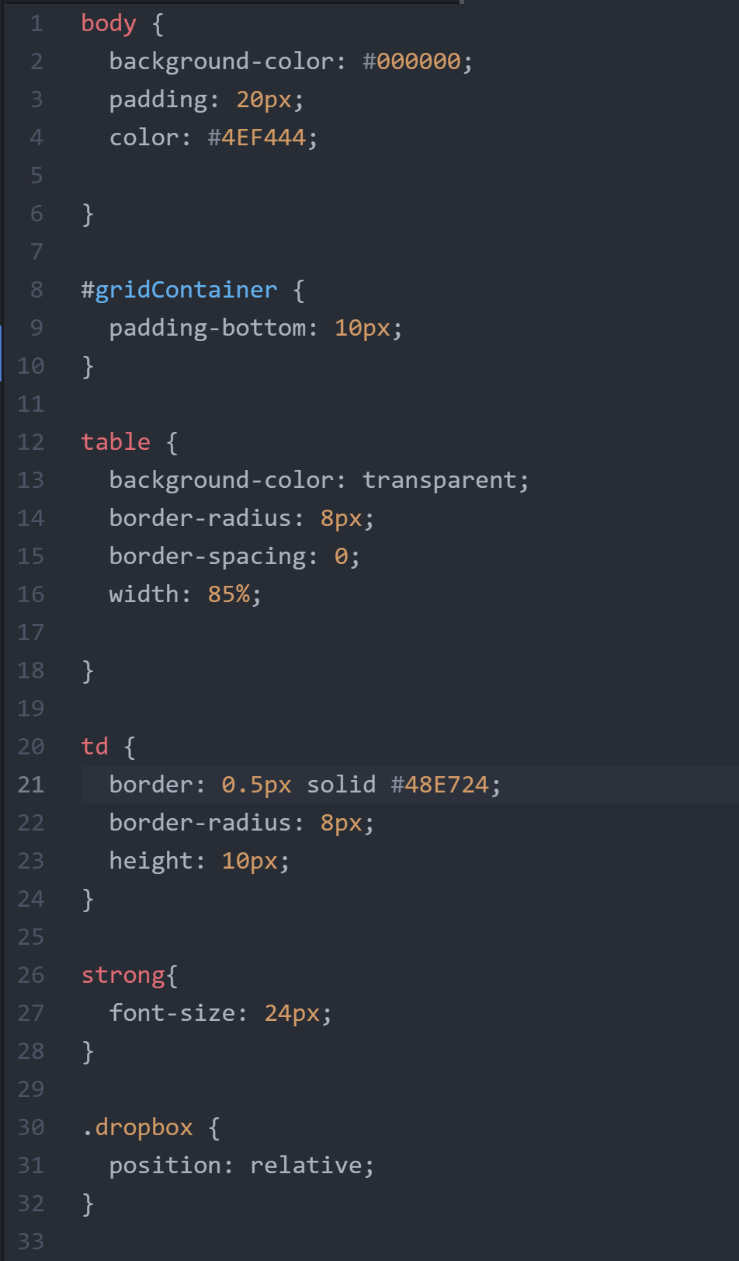
CSS Code:
Styling code for the game.
Defines style for:
Background.
Tables & Table Cells

Slide 27
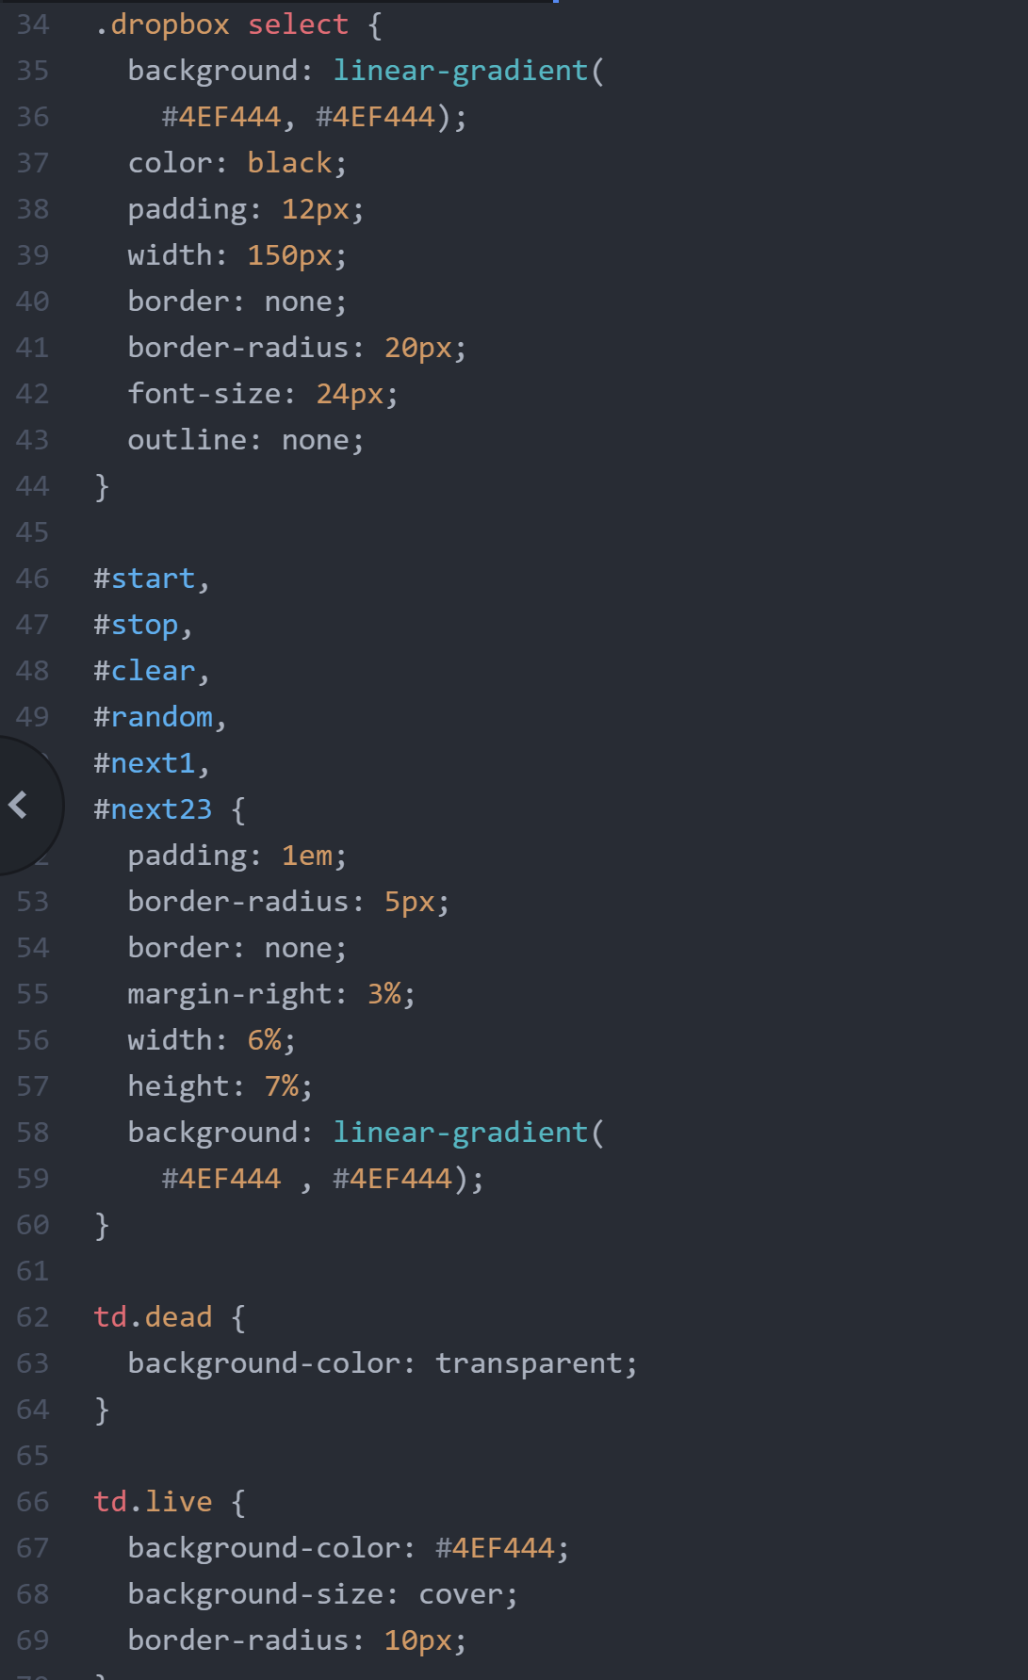
CSS Code:
CSS Code for:
The Controls
The individual cells.
Dead cells are transparent.
Live cells are colored green.

Slide 28
Demonstration

